Slide 1
Credit Card Default Detection
Presented by :
Nikhil Chouhan
Yash S Admuthe
Jerry Veembukattu Thomas
Prof. Dr. Shucheng Yu
CPE 695-A

Slide 2
Agenda
1. Introduction
2. Exploratory Data Analysis
3. Machine Learning Algorithm Selection
4. Models Implementation
4.1 Logistic Regression
4.2 K-Nearest Neighbors(KNN)
4.3 Random Forest
4.4 Artificial Neural Network
4.5 ADABOOST
4.6 XGBOOST
5. Result Analysis
6. Conclusion

Slide 3
INtroduction
This project aims to build a credit default model for a retail bank’s credit card portfolio.
Model can identify the consumers who are likely to default on their credit card payments over the next 12 months.
Predicting credit default will be used to reduce the bank’s future losses.
Based on the bank’s experience, the number of derogatory reports is a strong indicator of default. This is all that the information we are able to get from the bank at the moment. Currently, they do not have the expertise to provide any clarification on this data and are also unsure about other variables captured by their systems.

Slide 4
Data Description & wrangling
This data set consists of 13,444 observations with 14 variables.
In data pre-processing, we followed several steps like data cleaning, data integration, data reduction and data transformation.
Reduced number of predictors from 14 to 13.
Example of deleted predictors :
- Logspend
Example of important predictors:
- Cardhldr, default, age, acadmos, adepcnt, majordrg, minnordrg, ownrent, income, selfemp, incper, exp_inc, spending.
Treated null values with median.

Slide 5
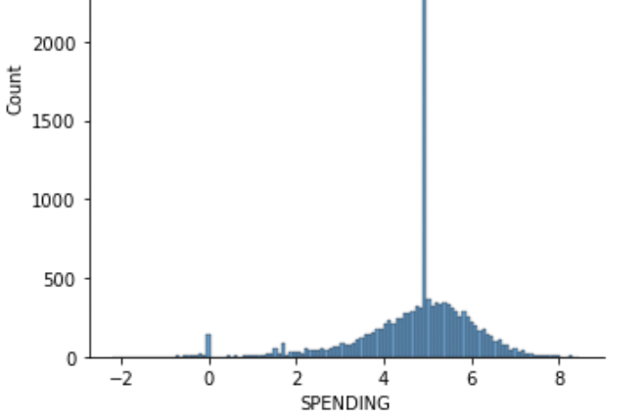
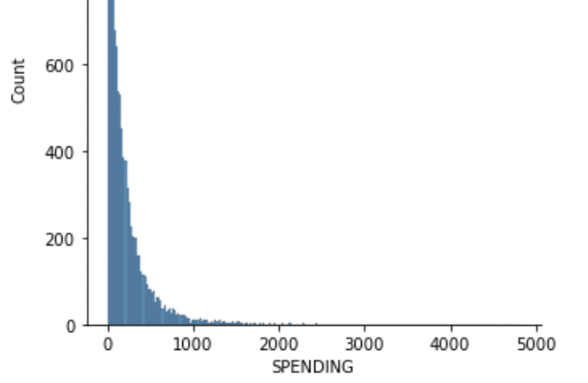
Feature Engineering
After log transformation
We visualized ‘spending’ feature and realized it was not normally distributed and hence we used log function to normalize the data.
We performed standard scalar on our training dataset to remove the mean and scales each feature/variable to unit variance.
Before log transformation

Slide 6

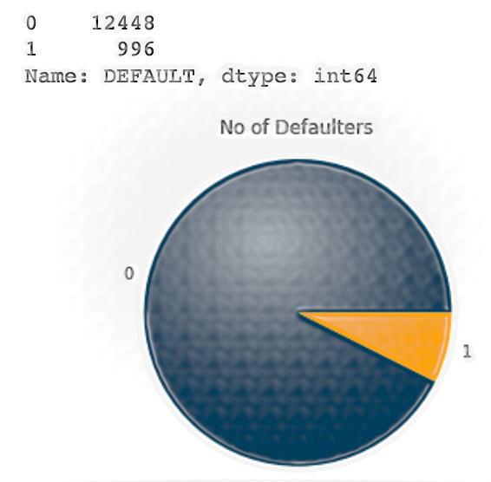
Data Visualization
In data visualization, we are represented relations between different features
We realized the dataset was imbalanced and performed undersampling

Slide 7
Model Implementation
Algorithms implemented on data are:
Logistic Regression
K-Nearest Neighbors (KNN)
Random Forest
Artificial Neural Network (ANN)
ADABOOST
XGBOOST

Slide 8
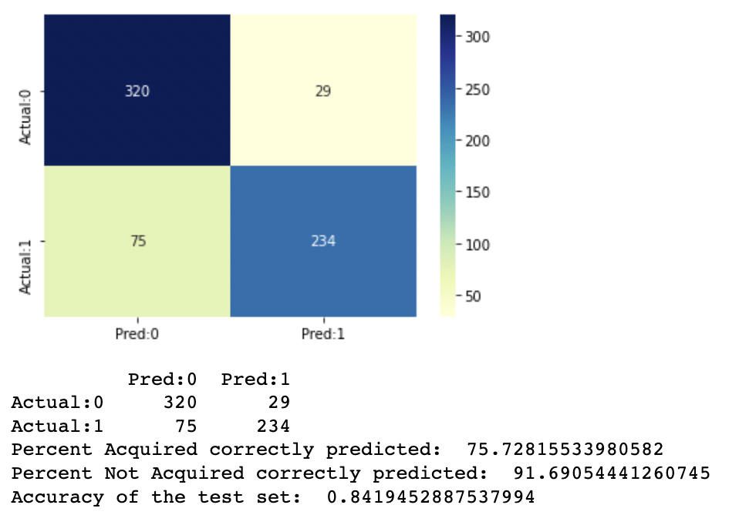
Logistic Regression
We used Logistic Regression to understand the relationship between the dependent variable and one or more independent variables by estimating probabilities using a logistic regression equation. This type of analysis helps you predict the likelihood of an event happening.
The logistic regression has a accuracy rate of 84.19 percent with accuracy of correctly predicting defaulters as 75.72 percent and not correctly predicted as 91.69 percent.

Slide 9
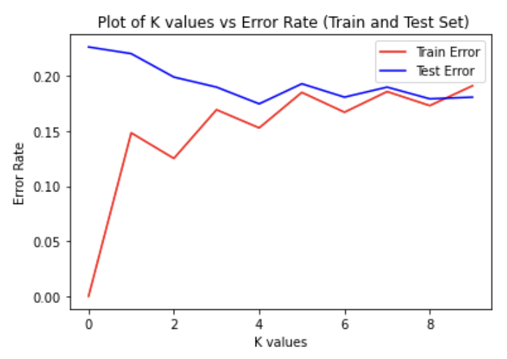
K-Nearest Neighbors (KNN)
K Nearest Neighbor (KNN) algorithm is a supervised algorithms.
Based on the most relevant features we will be using KNN to predict whether there is a default on credit card or not.
This will be working according to the nearest neighbor.
K is a crucial parameter in the KNN algorithm. Using error curves the figure below shows error curves for different values of K for training and test data.

Slide 10
Random Forest
Random Forest classification algorithm utilizes ensemble learning, which is a technique that combines many classifiers to provide solutions to complex problems.
By developing multiple decision trees and considering the majority of the output values form these decision trees, we will be able to correctly predict whether there is a default on credit card or not.
Random Forest algorithm introduces extra randomness when growing trees and prediction obtained at the end of training is more than that of the decision trees.
It is because the output chosen by the majority of the decision trees becomes the final output of the random forest algorithm.

Slide 11
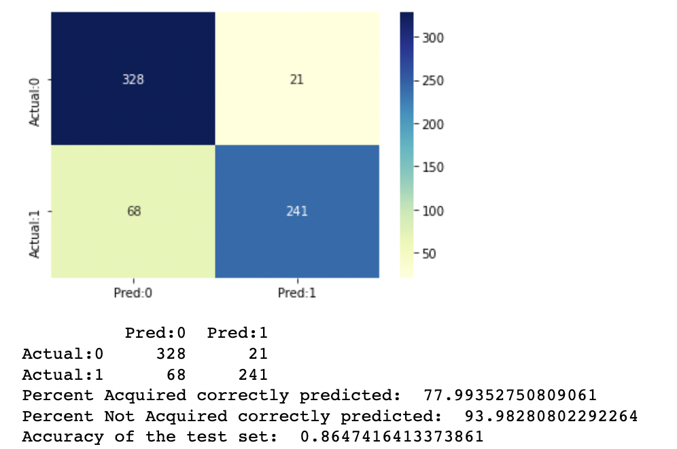

RANDOM FOREST
We got the accuracy of 86.4 percent using random forest classifier.

Slide 12
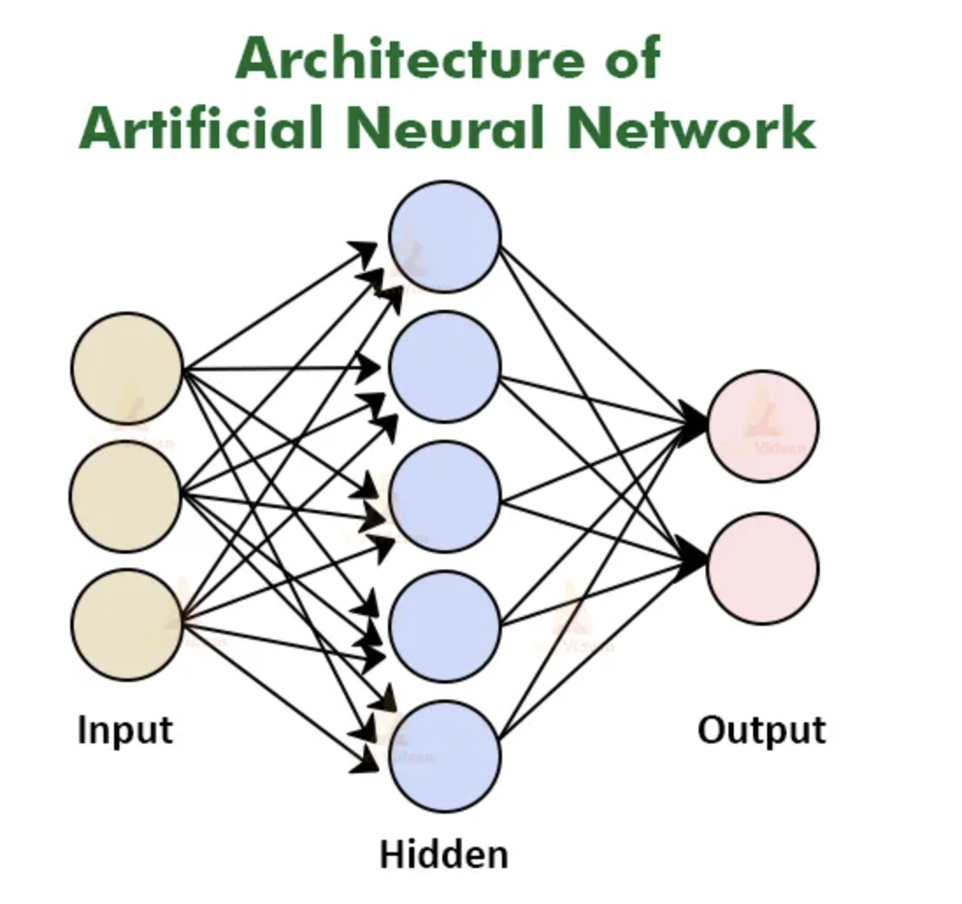
Artificial Neural Network (ANN)
Artificial Neural Networks(ANN) are part of supervised machine learning where we will be having input as well as corresponding output present in our dataset. Our whole aim is to figure out a way of mapping this input to the respective output. ANN can be used for solving both regression and classification problems.
Using ANN, we got an accuracy of 87 percent

Slide 13
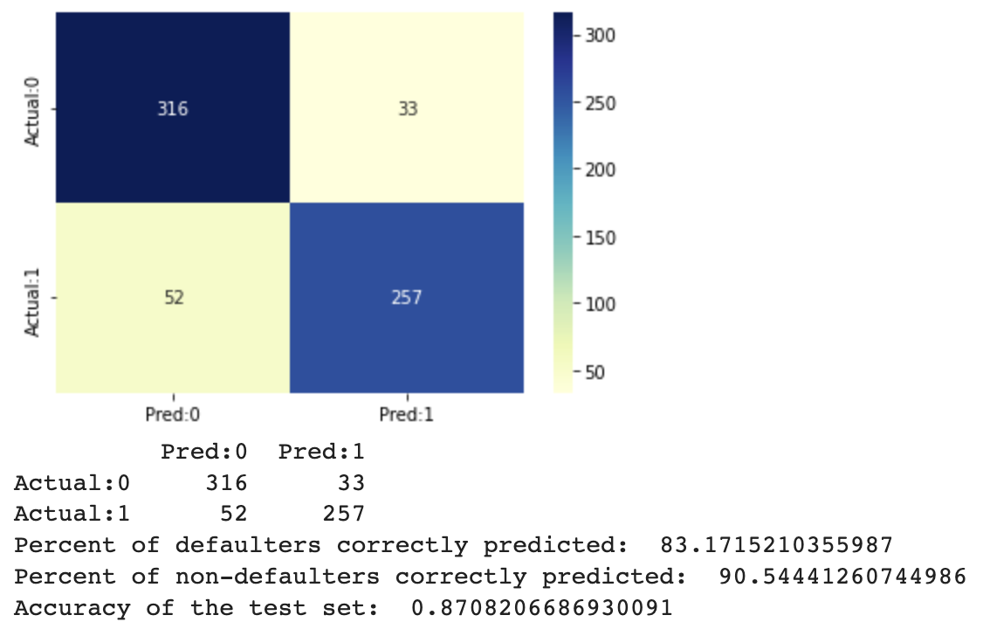
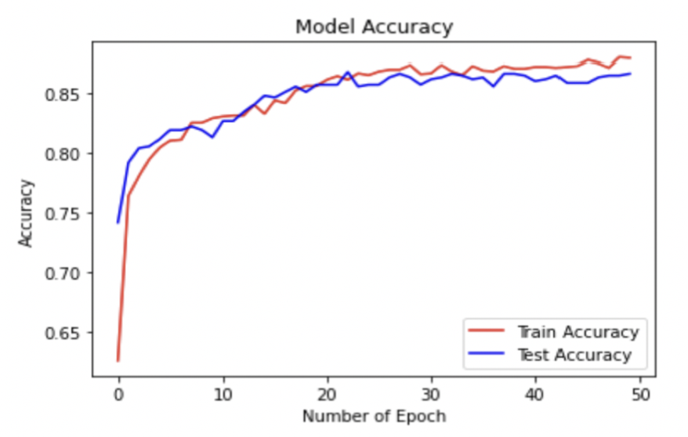
ANN
We got an accuracy of 87.08 doing some hyper-parameter tunning using Artificial Neural Network(ANN).
Performed hyperparameter tuning to improve accuracy.
rand

Slide 14
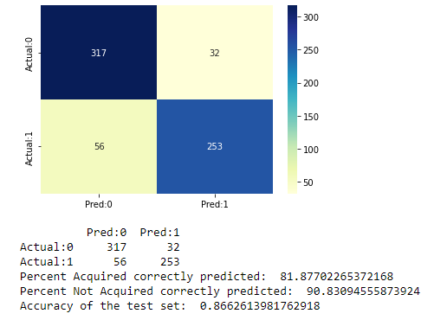
ADABOOST
AdaBoost is one of the first boosting algorithms to be adapted in solving practices.
AdaBoost helps you combine multiple “weak classifiers” into a single “strong classifier”
The adaptive boosting has an accuracy rate of 86 percent.

Slide 15
XGBoost
XGBoost – eXtreme Gradient Boosting
Optimized implementation of Gradient Boosting Algorithm
In Gradient Boosting, method tries to fit new predictors to residual errors made by previous predictors
XGBoost – faster, scalable, portable
Implementation – used GridSearchCV to find best number of estimators, then passed value for n_estimators while training

Slide 16

We got the highest accuracy of 87.99 doing some hyper-parameter tunning using XGBOOST algorithm.

Slide 17
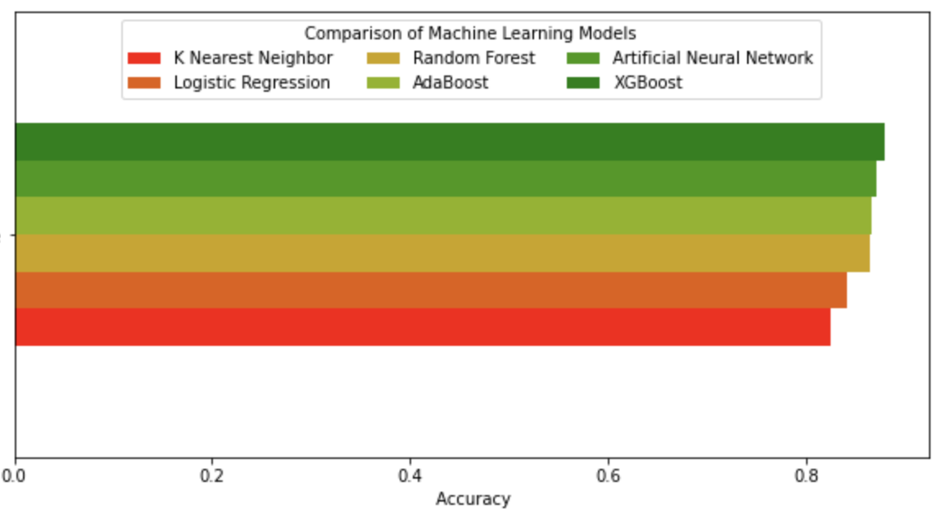
Conclusion
After implementation all six machine learning algorithms, we noticed that Adaboost, Artificial Neural Net and XGBoost gives us better prediction on our problem statement.
The accuracy achieved by the XGBoost is 88 percent.
Hence we can confidently say we can use XGBOOST for future predictions.

Slide 18
THANK YOU Presentation link - https://stevens.zoom.us/rec/share/vd73PsLD1rcGSSlG9KaiZFrHnWMLtwqBn8Y3vctDgKIxi6CiqQzmLI2TbXm6cgIo.kGYDkdO_kRvFPGyF?startTime=1651871029000

